Slide 1
Medical Imaging Final Report
Qiong-Wen
Date: January 6, 2021

Slide 2
Outline
1. Radon Transform
2. Filter Back Projection
3. GUI design

Slide 3
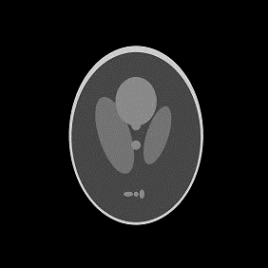

Radon transform
Rotate Image
theta = np.arange(0, 181, dTheta=1)
for n in range(numAngles): rotImgObj = img.rotate(-theta[n], resample=Image.BILINEAR) im1.set_data(rotImgObj) sinogram[:, n] = np.sum(rotImgObj, axis=0) # normalize value sino = Image.fromarray((sinogram - np.min(sinogram)) / np.ptp(sinogram) * 255)

Slide 4
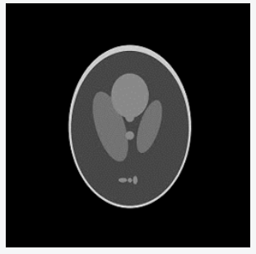
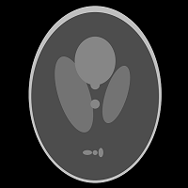

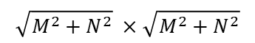
Radon transform-rotation
Zero Padding Image:
Img(X’1, y’1) | Img(X’2, y’2) | Img(X’3, y’3)
Img(X’4, y’4) | Img(X’5, y’5) | Img(X’6, y’6)
Img(X’7, y’7) | Img(X’8, y’8) | Img(X’9, y’9)
MxN
$$\sqrt{M^{2}+N^{2}} ×\sqrt{M^{2}+N^{2}}$$
x1, y1 | x2, y2 | x3, y3
x4, y4 | x5, y5 | x6, y6
x7, y7 | x8, y8 | x9, y9
Clockwise Rotation
X’1, y’1 | X’2, y’2 | X’3, y’3
X’4, y’4 | X’5, y’5 | X’6, y’6
X’7, y’7 | X’8, y’8 | X’9, y’9
$$\left[\begin{matrix}x^{′} \\ y^{′}\end{matrix}\right]=\left[\begin{matrix}cos∅ & sin∅ \\ −sin∅ & cos∅\end{matrix}\right]\left[\begin{matrix}x \\ y\end{matrix}\right]$$

Slide 5

back projection
+

Slide 6
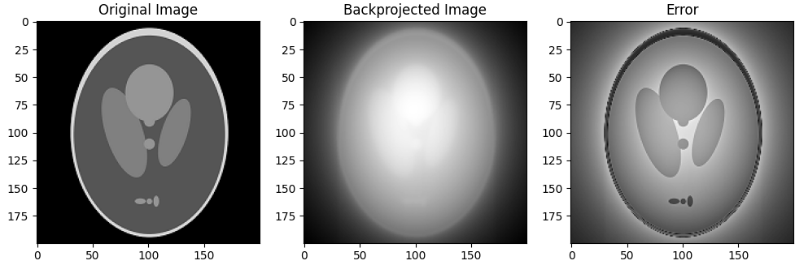
back projection
for n in range(numAngles): Xrot = X * np.cos(theta[n]) + Y * np.sin(theta[n]) XrotCor = np.round(Xrot + imageLen / 2) XrotCor = XrotCor.astype('int') projMatrix = np.zeros((imageLen, imageLen)) m0, m1 = np.where((XrotCor >= 0) & (XrotCor <= (imageLen - 1))) s = sinogram[:, n] # get projection projMatrix[m0, m1] = s[XrotCor[m0, m1]] # backproject in-bounds data reconMatrix += projMatrix im = Image.fromarray((reconMatrix - np.min(reconMatrix)) / np.ptp(reconMatrix) * 255)

Slide 7
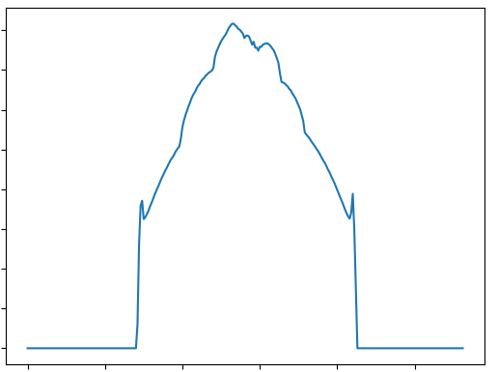
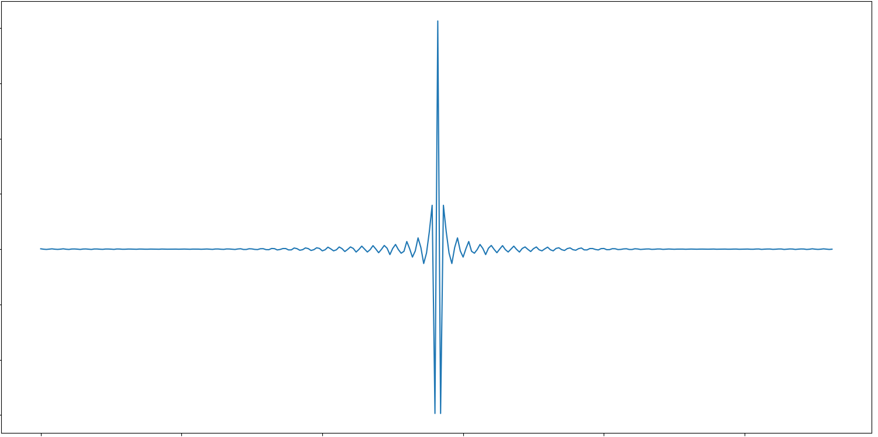
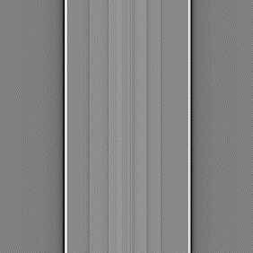
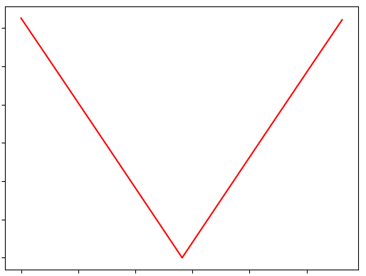
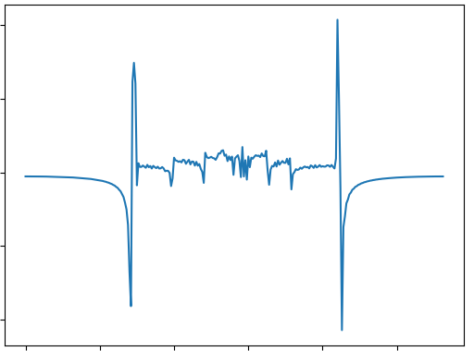
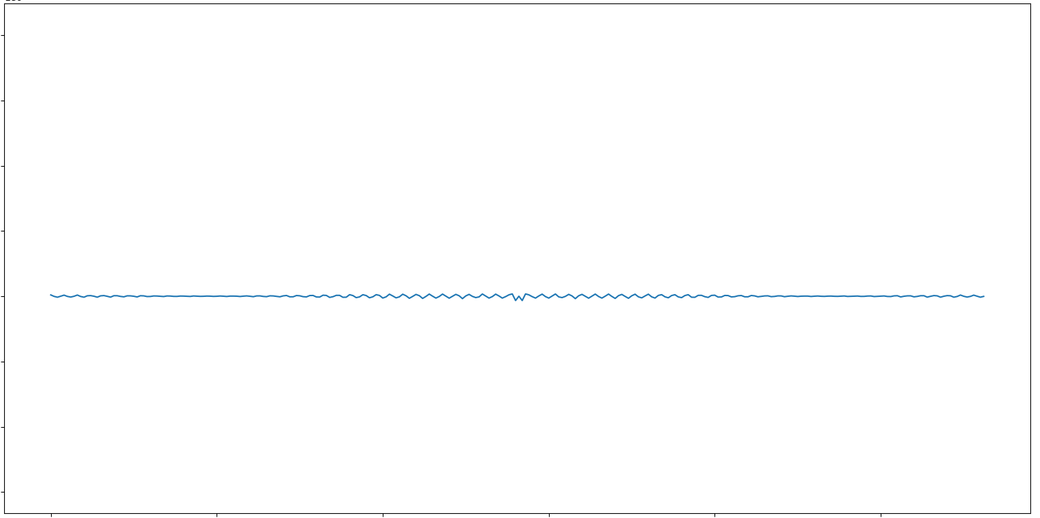
Filter back projection
FFT
filter
ramp filter
IFFT

Slide 8
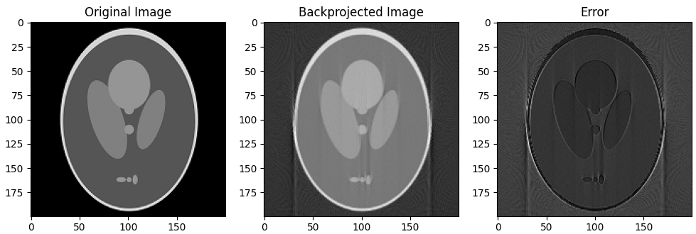
Filter back projection
for i in range(numAngles): projfft = DFT.DFT_one(sino[:, i]) # Filter filtProj = projfft * filt filtSino[:, i] = np.real(DFT.iDFT_one(filtProj))

Slide 9
GUI design
User interface for computed tomography reconstruction
Develop Environment :
Python +Matplotlib + Pyqt5 + Qt designer

Slide 10
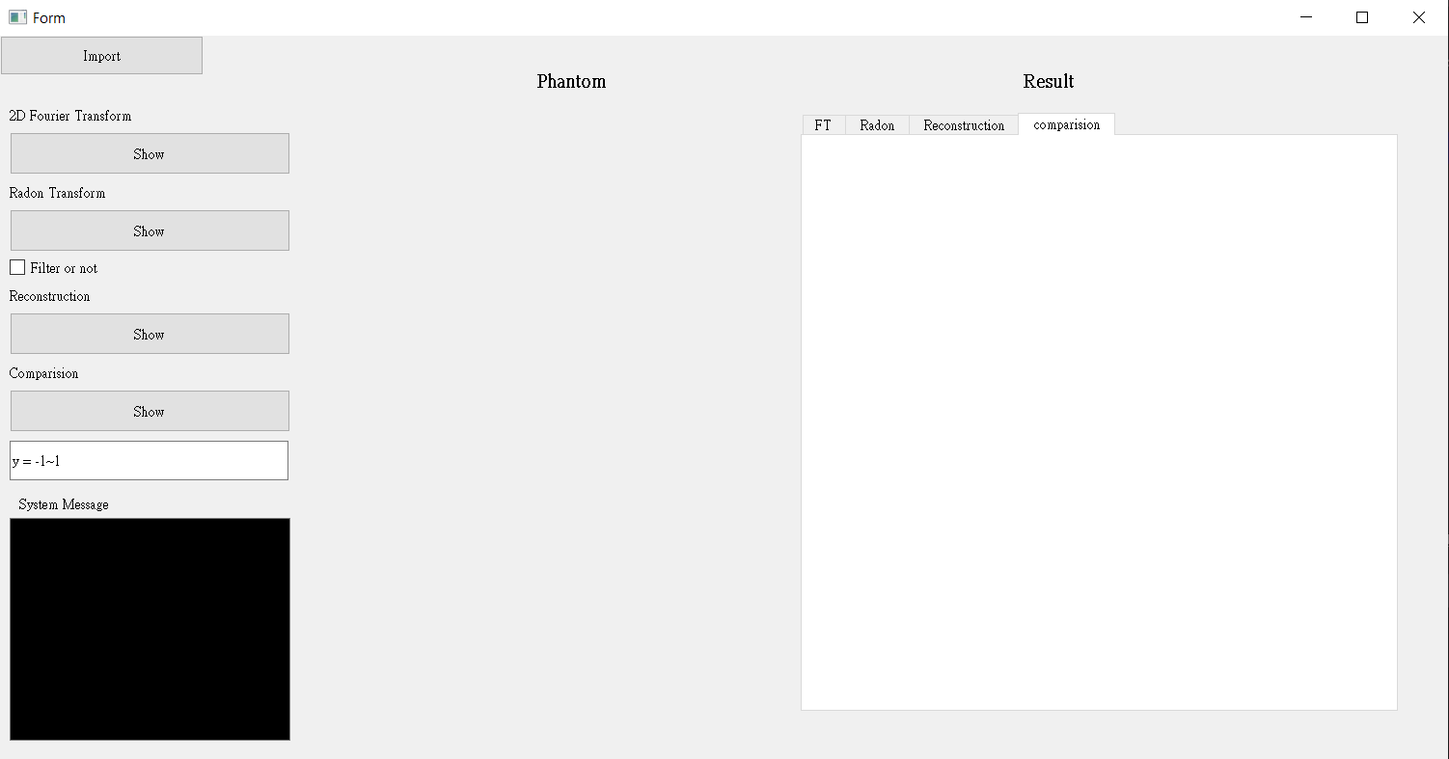
Only back projection or
Filter back projection
Enter a line y =? , Make Numerical comparison of the true and the reconstructed values
Processing message + Error message

Slide 11
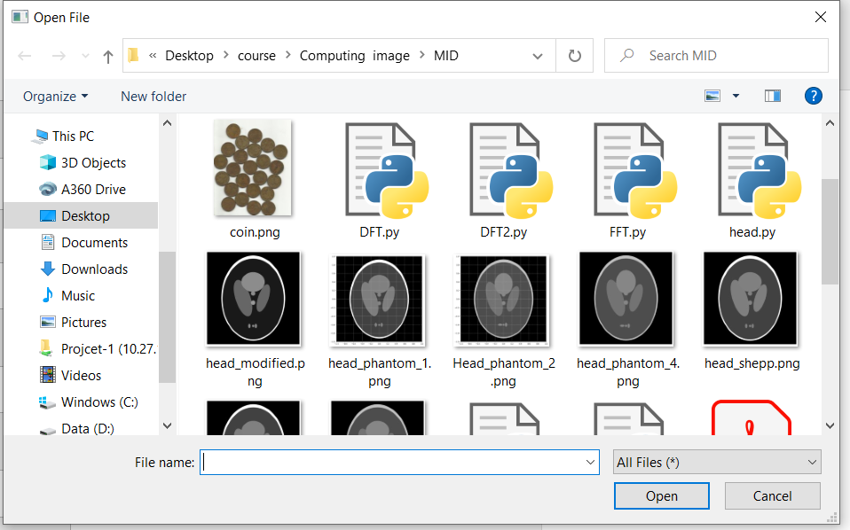
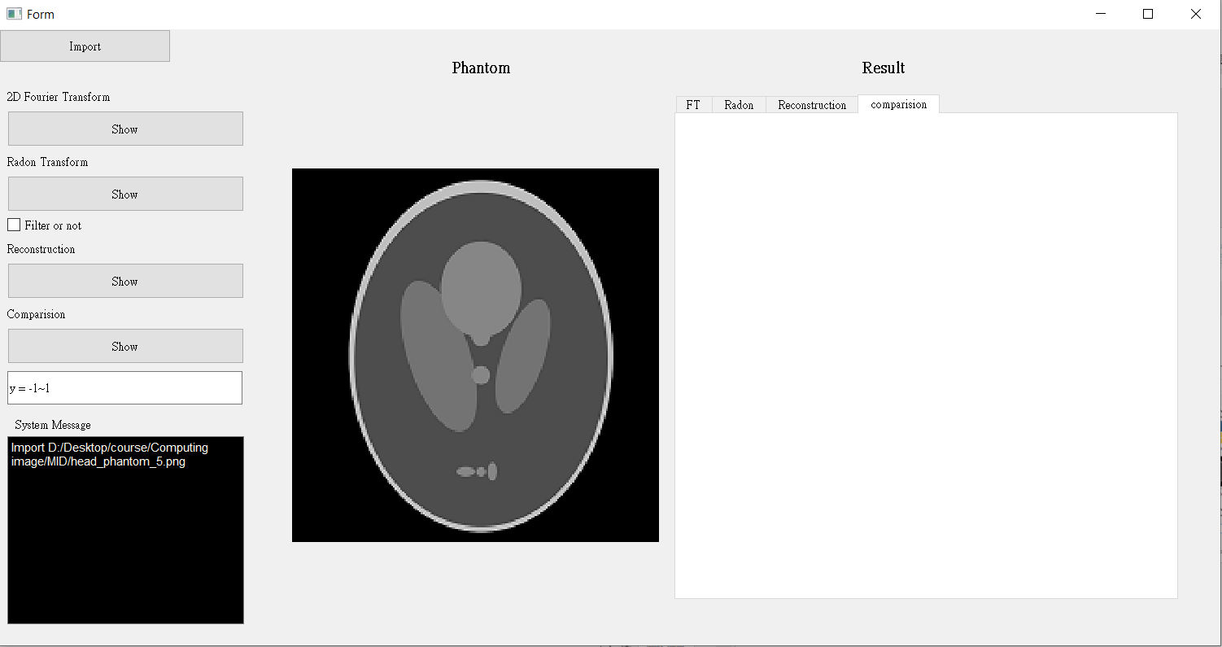
Import File (phantom)

Slide 12
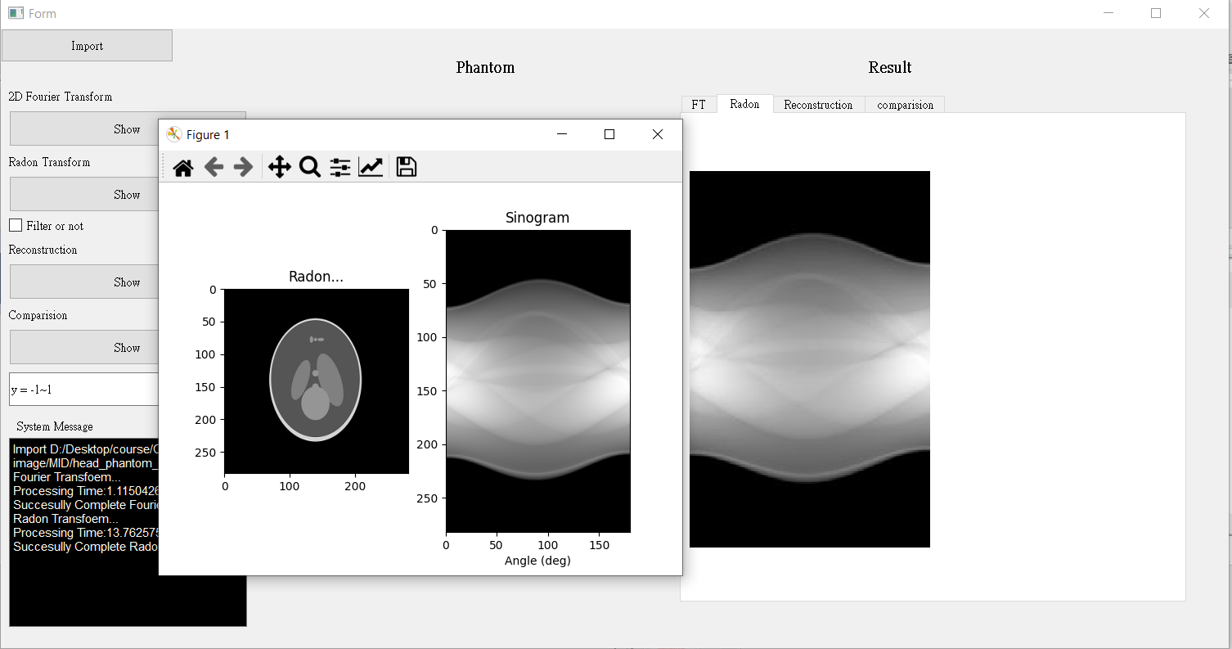
Radon Transform

Slide 13
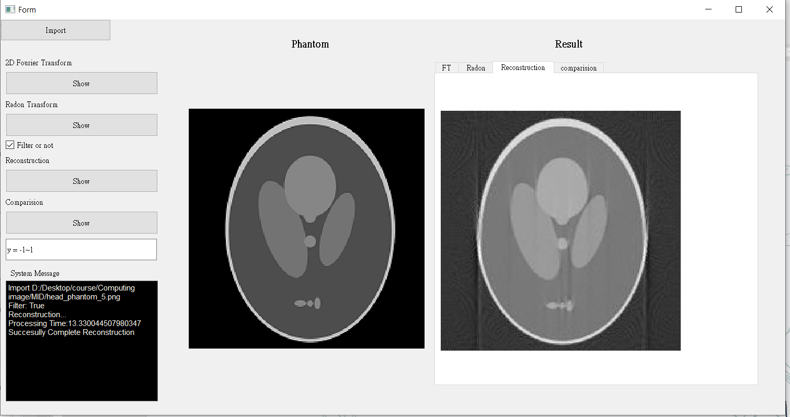
Reconstruction

Slide 14
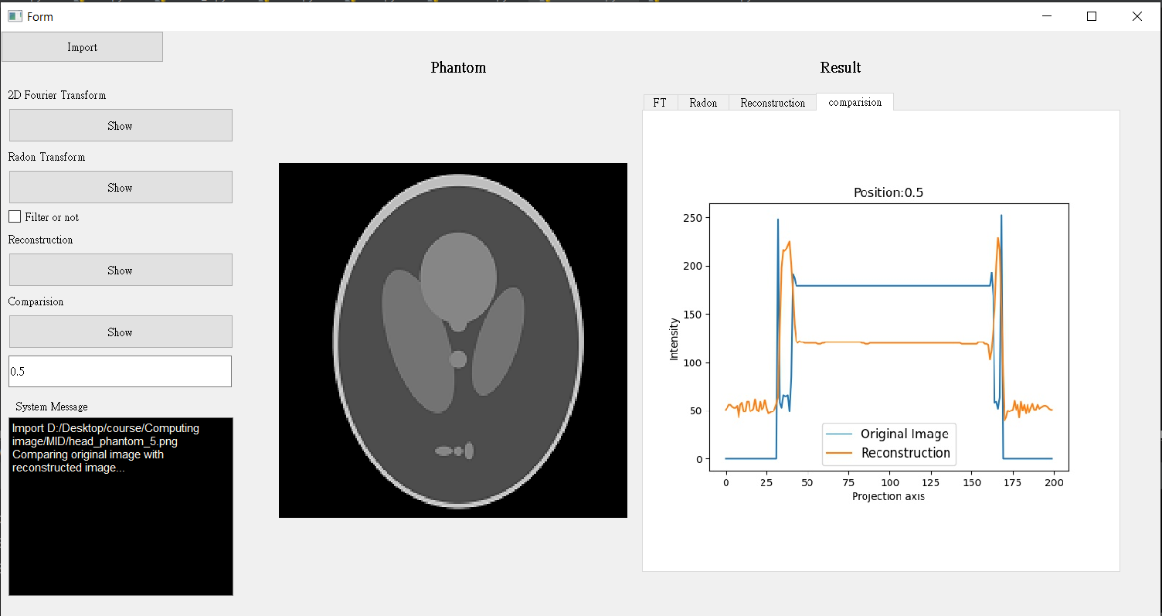

Slide 15
Thank you

